Slide 1
PREDICTIVE ANALYSIS OF GLOBAL TERRORISM
GROUP 9:
ATCHUTA ANUDEEP REDDY GANUGAPANTA
PRADEEP POONATI
SAI SIRISHA PYARASANI

Slide 2


Slide 3
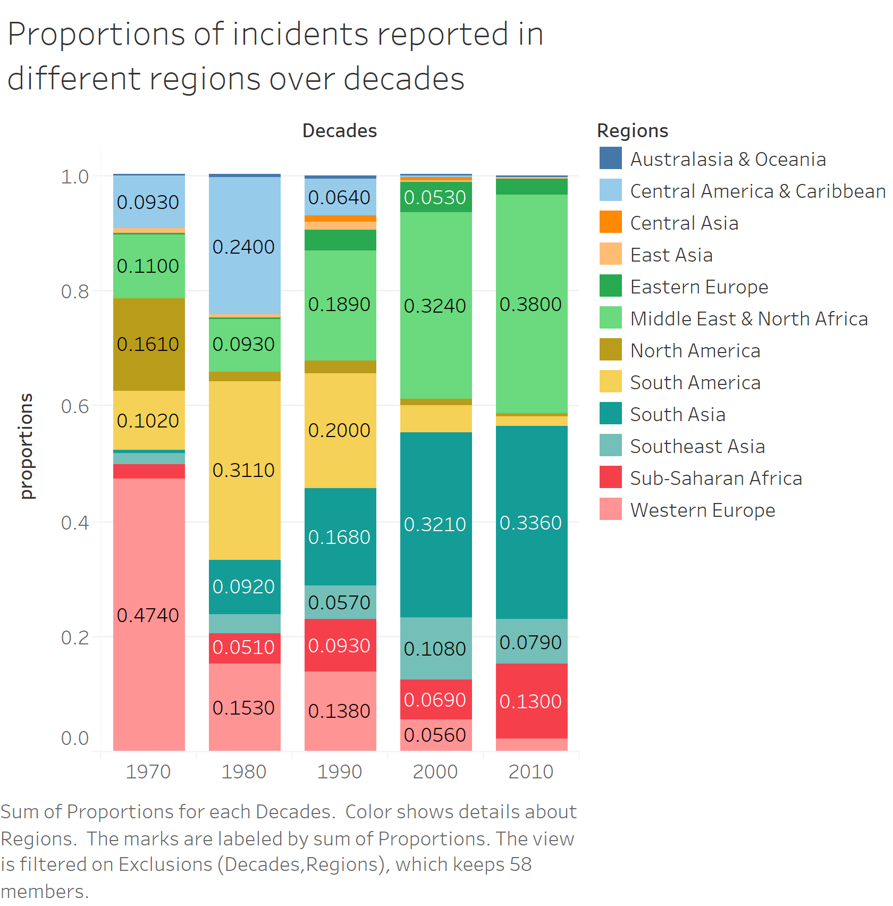

Slide 4
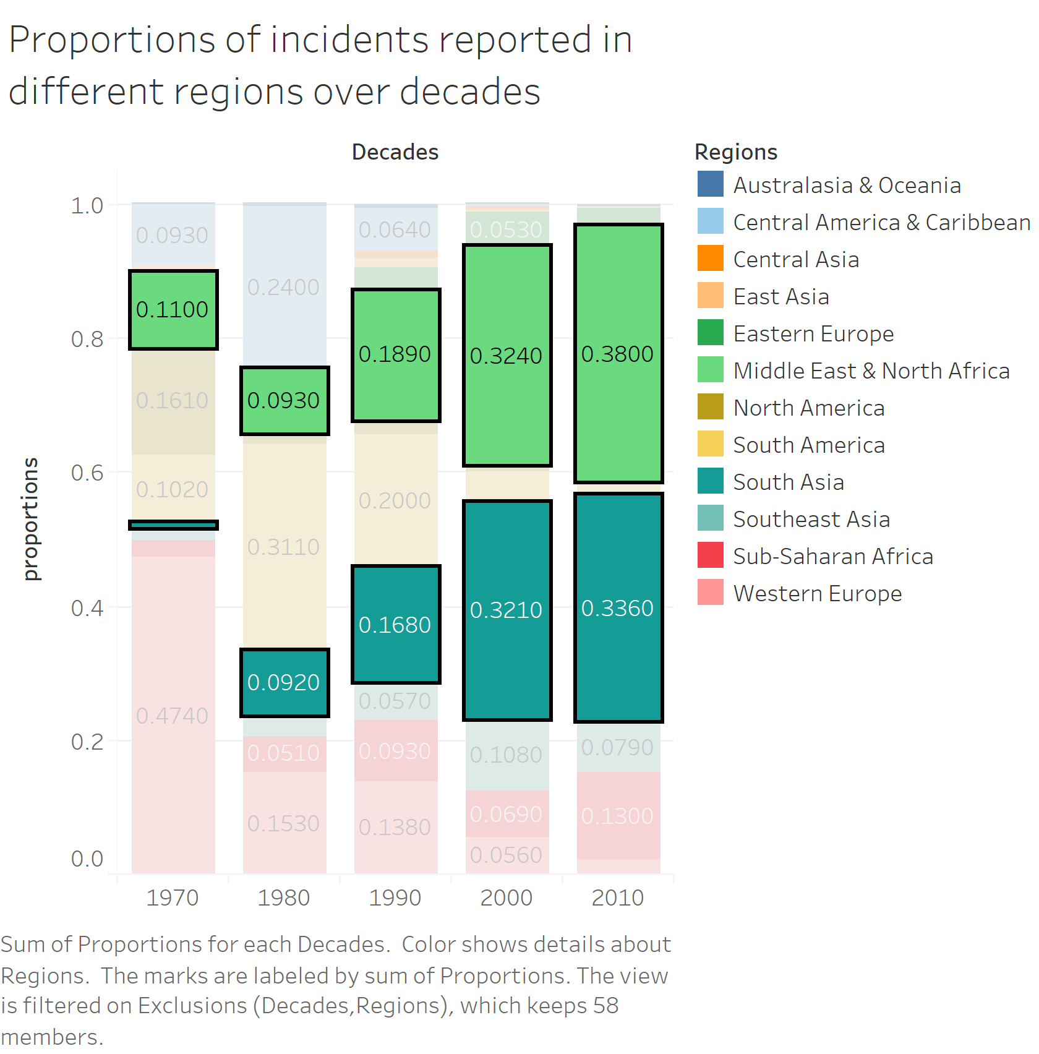

Slide 5
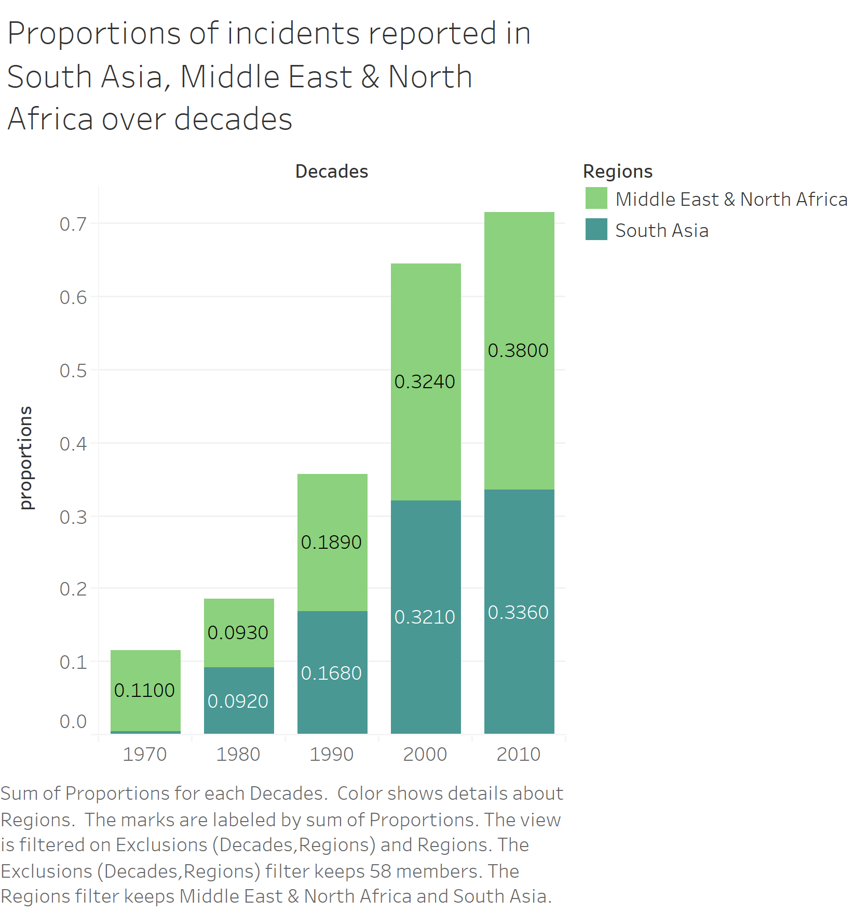

Slide 6
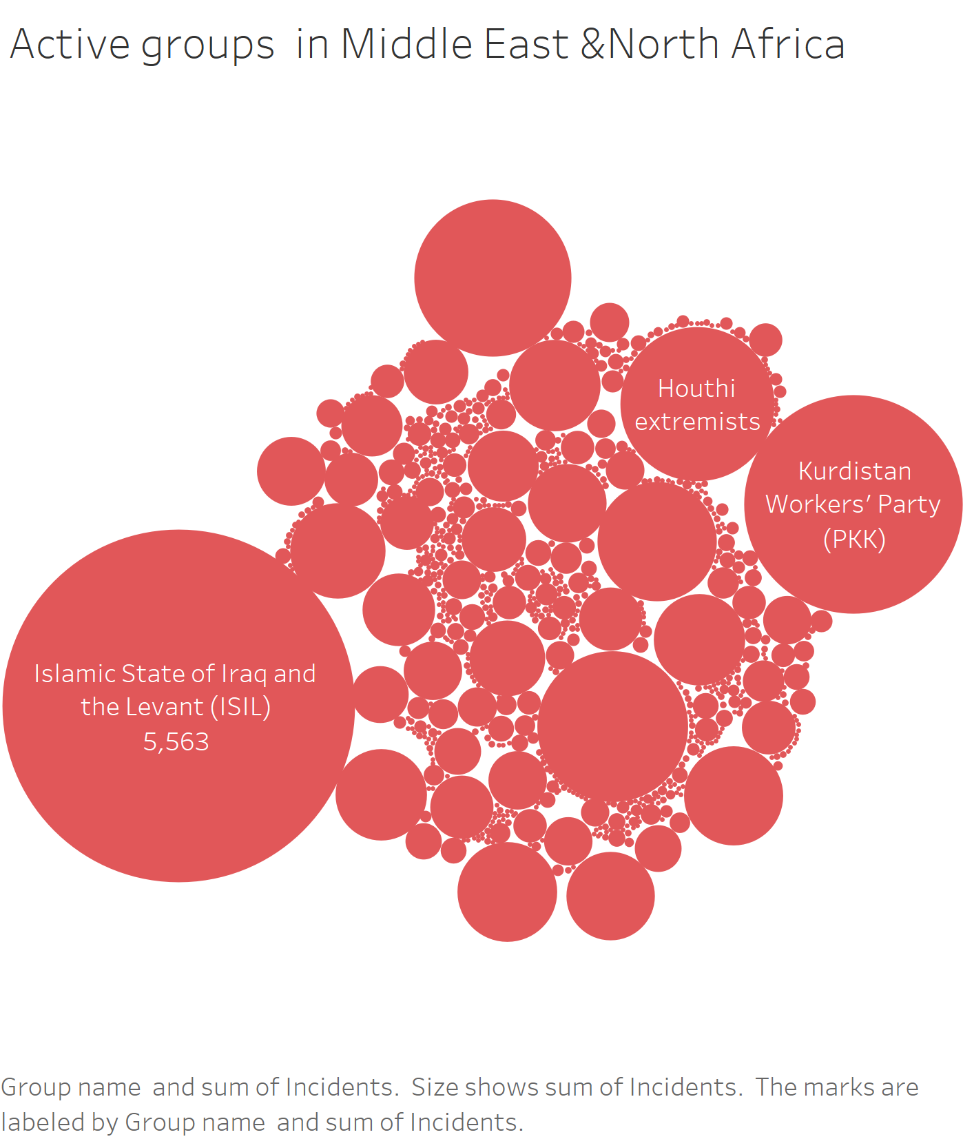

Slide 7
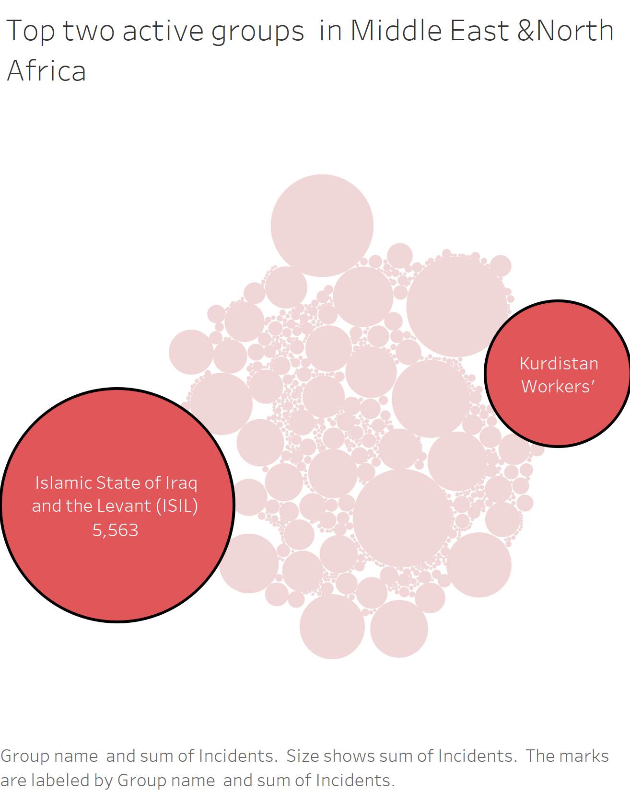

Slide 8
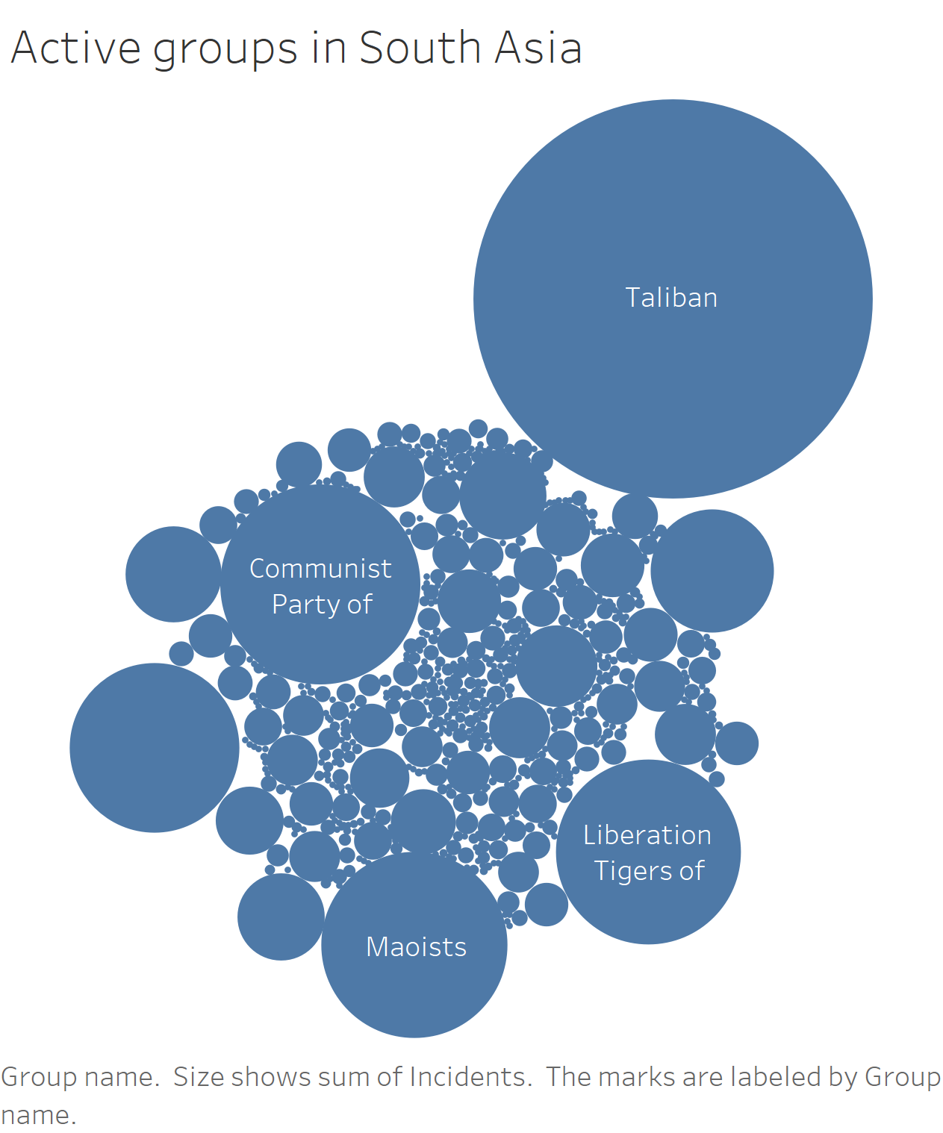
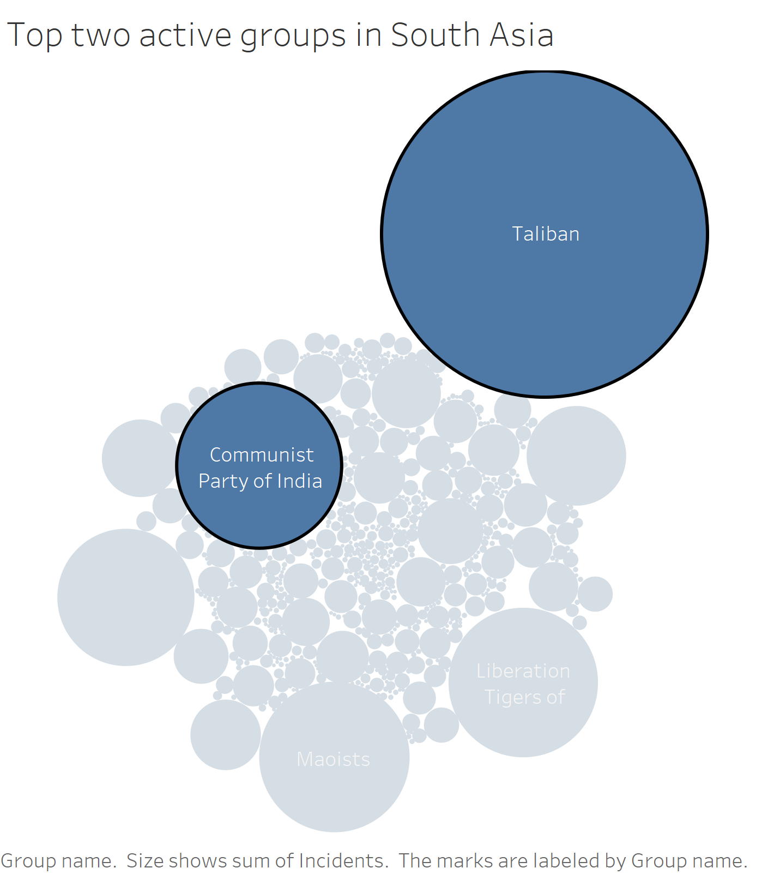

Slide 9
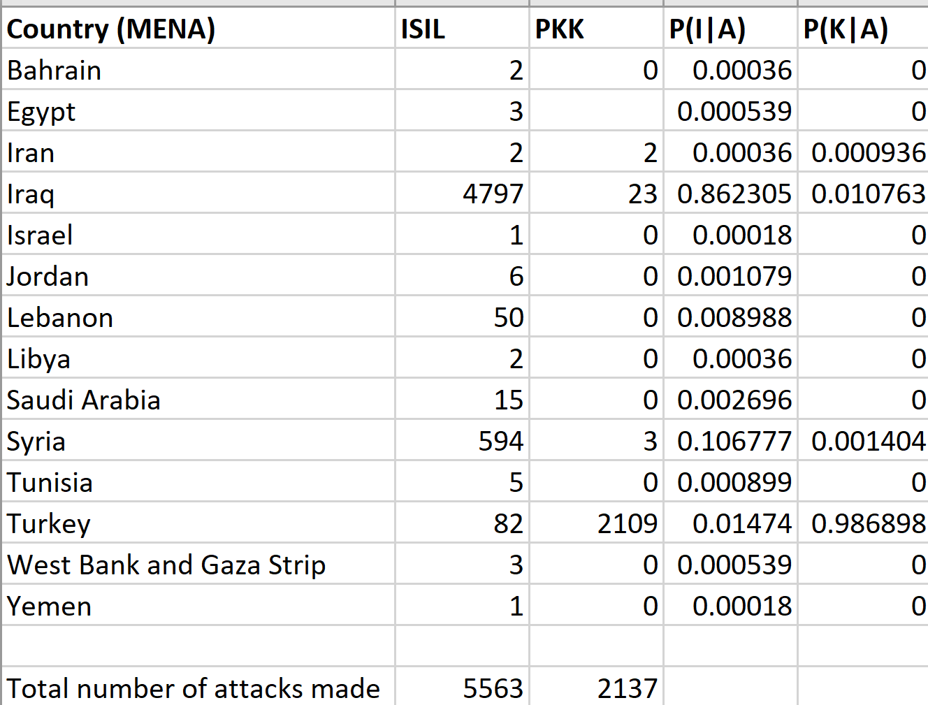

Slide 10
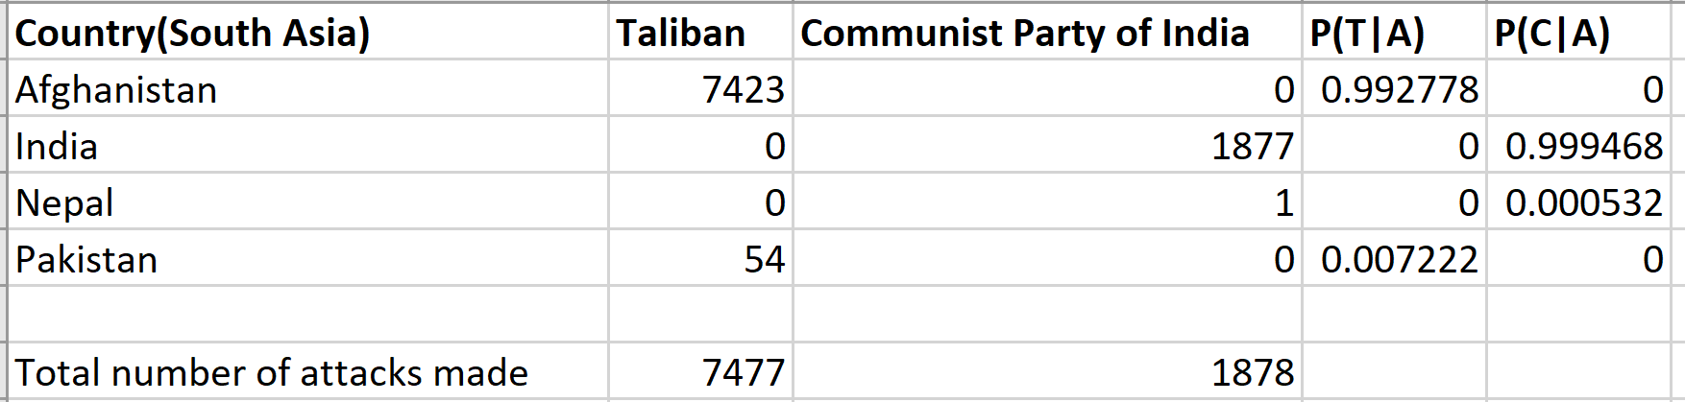

Slide 11
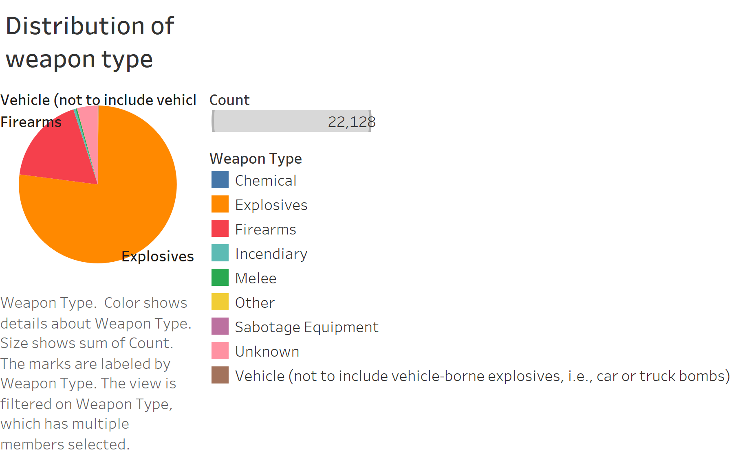

Slide 12
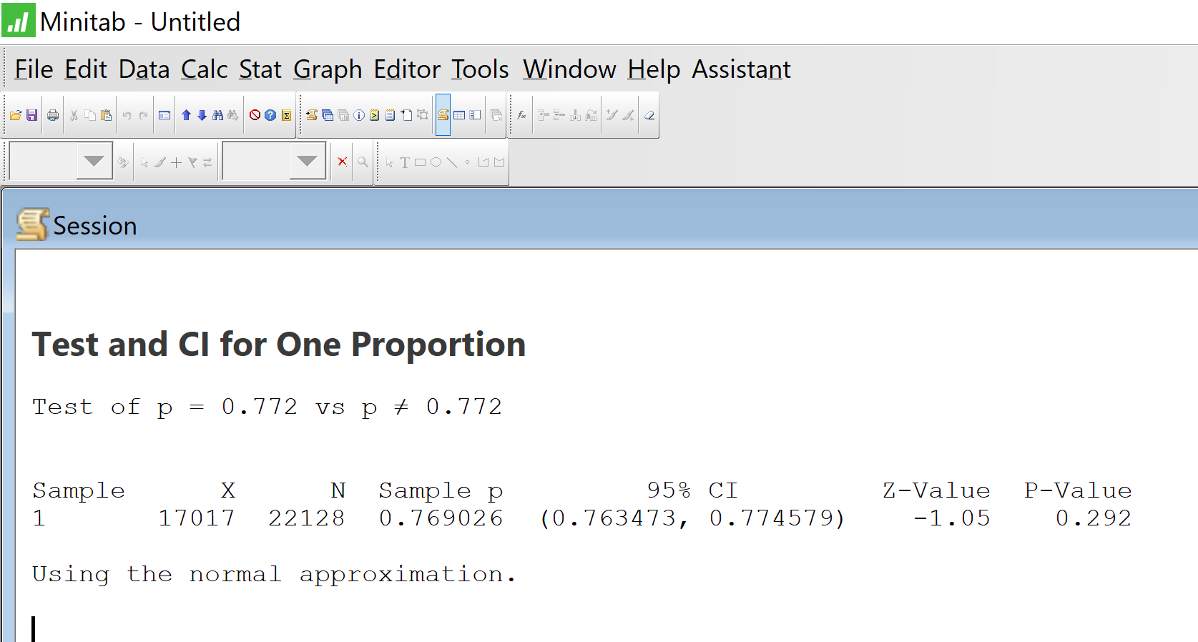

Slide 13


Slide 14


Slide 15

Please rate us !!!

